Slide 1
Cognitive Services and deep learning
Notes:
Information in this document, including URL and other Internet Web site references, is subject to change without notice. Unless otherwise noted, the example companies, organizations, products, domain names, e-mail addresses, logos, people, places, and events depicted herein are fictitious, and no association with any real company, organization, product, domain name, e-mail address, logo, person, place or event is intended or should be inferred. Complying with all applicable copyright laws is the responsibility of the user. Without limiting the rights under copyright, no part of this document may be reproduced, stored in or introduced into a retrieval system, or transmitted in any form or by any means (electronic, mechanical, photocopying, recording, or otherwise), or for any purpose, without the express written permission of Microsoft Corporation.
Microsoft may have patents, patent applications, trademarks, copyrights, or other intellectual property rights covering subject matter in this document. Except as expressly provided in any written license agreement from Microsoft, the furnishing of this document does not give you any license to these patents, trademarks, copyrights, or other intellectual property.
The names of manufacturers, products, or URLs are provided for informational purposes only and Microsoft makes no representations and warranties, either expressed, implied, or statutory, regarding these manufacturers or the use of the products with any Microsoft technologies. The inclusion of a manufacturer or product does not imply endorsement of Microsoft of the manufacturer or product. Links may be provided to third party sites. Such sites are not under the control of Microsoft and Microsoft is not responsible for the contents of any linked site or any link contained in a linked site, or any changes or updates to such sites. Microsoft is not responsible for webcasting or any other form of transmission received from any linked site. Microsoft is providing these links to you only as a convenience, and the inclusion of any link does not imply endorsement of Microsoft of the site or the products contained therein.
© 2017 Microsoft Corporation. All rights reserved.
Microsoft and the trademarks listed at https://www.microsoft.com/en-us/legal/intellectualproperty/Trademarks/Usage/General.aspx are trademarks of the Microsoft group of companies. All other trademarks are property of their respective owners.

Slide 2
Abstract and learning objectives
In this workshop, you learn to combine both pre-built artificial intelligence (AI) in the form of various Cognitive Services with custom AI in the form of services built and deployed with Azure Machine Learning service. You will learn to create intelligent solutions atop unstructured text data by designing and implementing a text analytics pipeline. You will also learn how to build a binary classifier using a recurrent neural network that can be used to classify the textual data. You will also learn how to deploy multiple kinds of predictive services using Azure Machine Learning and learn to integrate with the Computer Vision API and the Text Analytics API from Cognitive Services.
Along the way, you will get to consider the following technologies and services:
Azure Machine Learning service
Cognitive Services
Computer Vision API
Text Analytics API
Keras
TensorFlow
ONNX

Slide 3
Step 1: Review the customer case study
Outcome
Analyze your customer needs
Timeframe
15 minutes

Slide 4


Customer situation
Contoso Ltd, operating in the United States, provides insurance packages for U.S. consumers. They are:
Looking to build a next-generation platform for its insurance products
Have identified claims processing as the area of focus
Concerned that it currently takes significant time for an agent to read through and process the content submitted with each claim
Finding that it is difficult for agents to find particular claim artifacts when returning to a claim after a while

Slide 5


Customer situation
Two sets of issues where they envision amplifying the capabilities of their agents with AI:
Processing free-text responses:
Classifying claims as “home” or “auto”
Scoring claim sentiment
Summarizing long claim text
Processing images for searchability:
Automatic captioning of image contents
Tagging of images
Extracting any text in the image

Slide 6
Customer needs
We receive a lot of useful information in the free-text responses. However, because the free-text responses can be lengthy, agents sometimes skip over them and miss vital details or spend too much time looking for a particular point when returning to a claim. We aren't confident we can automate this step. Still, we would like to have a standardized process that identifies the key entities in a claim and pulls them out into a separate list that agents can more easily review and then view the entity in the claim's context.
We need a solution that can "look" at a photo and provide a description of the photos' contents and tag the images with keywords, so agents can more easily find and refer to the picture later.
We are looking to amplify our agents' capabilities and improve their claims processing capabilities - not replace them. We want a solution that does the same.

Slide 7
Customer objections
We are skeptical about all the hype surrounding these "AI" solutions. It's hard to know what is feasible versus what is not possible with today's technology and Azure.
We know that are both pre-built AI and custom AI options available. We are confused as to when to choose one over the other.
We expect some part of our solution would require deep learning. Do you have any prescriptive guidance on how we might choose between investing in understanding and using TensorFlow or the Microsoft Cognitive Toolkit (CNTK)?

Slide 8
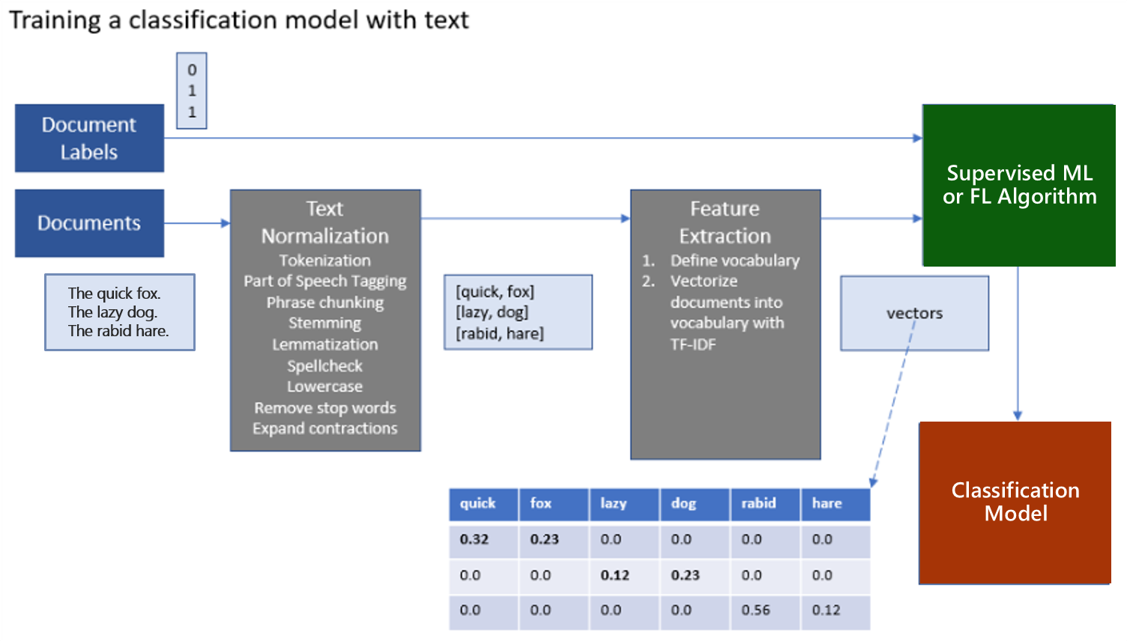
Common scenarios

Slide 9
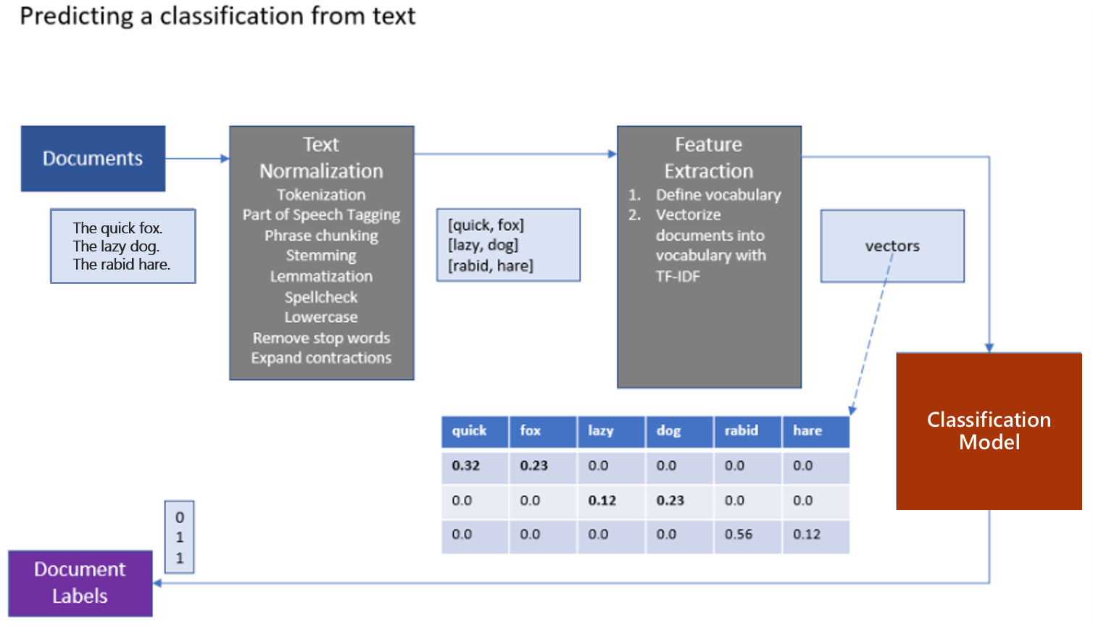
Common scenarios

Slide 10
Step 2: Design the solution
Outcome
Design a solution and prepare to present the solution to the target customer audience in a 15-minute chalk-talk format.
Timeframe
60 minutes
Business needs (10 minutes) | Respond to questions outlined in your guide and list the answers on a flipchart.
Design (35 minutes) | Design a solution for as many of the stated requirements as time allows. Show the solution on a flipchart.
Prepare (15 minutes) | Identify any customer needs that are not addressed with the proposed solution. Identify the benefits of your solution. Determine how you will respond to the customer’s objections. Prepare for a 15-minute presentation to the customer.

Slide 11
Step 3: Present the solution
Outcome
Present a solution to the target customer in a 15-minute chalk-talk format
Timeframe
30 minutes (15 minutes for each team to present and receive feedback)
Directions
Pair with another table
One table is the Microsoft team and the other table is the customer
The Microsoft team presents their proposed solution to the customer
The customer asks one of the objections from the list of objections in the case study
The Microsoft team responds to the objection
The customer team gives feedback to the Microsoft team

Slide 12
Wrap-up
Outcome
Identify the preferred solution for the case study
Identify solutions designed by other teams
Timeframe
15 minutes

Slide 13
Preferred target audience
Francine Fischer, CIO of Contoso Ltd.
The primary audience is the business and technology decision-makers. From the case study scenario, this would include the Director of Analytics.
Usually, we talk to the infrastructure managers, who report to the chief information officers (CIOs), or application sponsors, like a vice president (VP) line of business (LOB), or chief marketing officer (CMO), or to those that represent the business unit IT or developers that report to application sponsors.

Slide 14
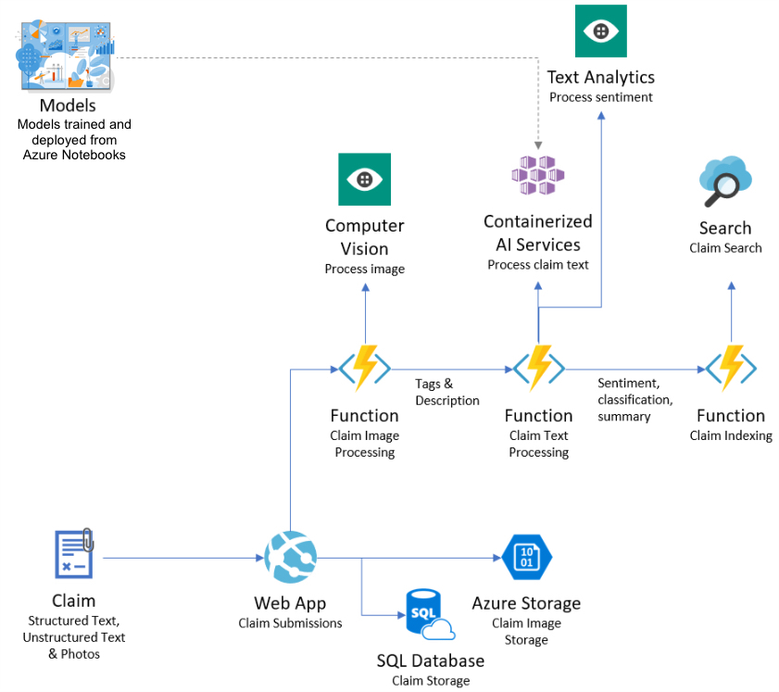
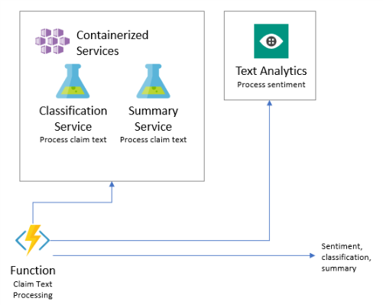
Preferred solution
High-level architecture
Notes:
After speaking with its team at Microsoft, Contoso decided to design their PoC solution in Azure. They would continue to use the web app and SQL database they already have running in Azure to handle claim submissions. They could build a claim enrichment pipeline by invoking a sequence of Azure Functions, where each of the coordinates calls to various AI-powered services.
The claim image processing functions would invoke the Computer Vision Cognitive Service for automatically creating the caption and the tags from any supplied claim images. A mixture of pre-built AI, in the form of Cognitive Services and custom AI in the form of Azure ML services, would be used to process the claim text. The models used for processing claims' text would be trained in Azure Machine Learning compute instance. These models could also be directly deployed from Azure Machine Learning compute instance using the Azure Machine Learning Service Python SDK. Azure Functions would coordinate the calls to the classifications and summary AI services, which would run as containerized web services in Azure Container Service. Simultaneously, the Text Analytics API could be invoked directly to provide a sentiment score for each claim text.
Once all claim processing has been completed, one final Azure Function could be used to insert the complete claim document into Azure Cognitive Search. The inserted document would contain the claim number as a field to always be tied back to the record store in Azure SQL Database.

Slide 15
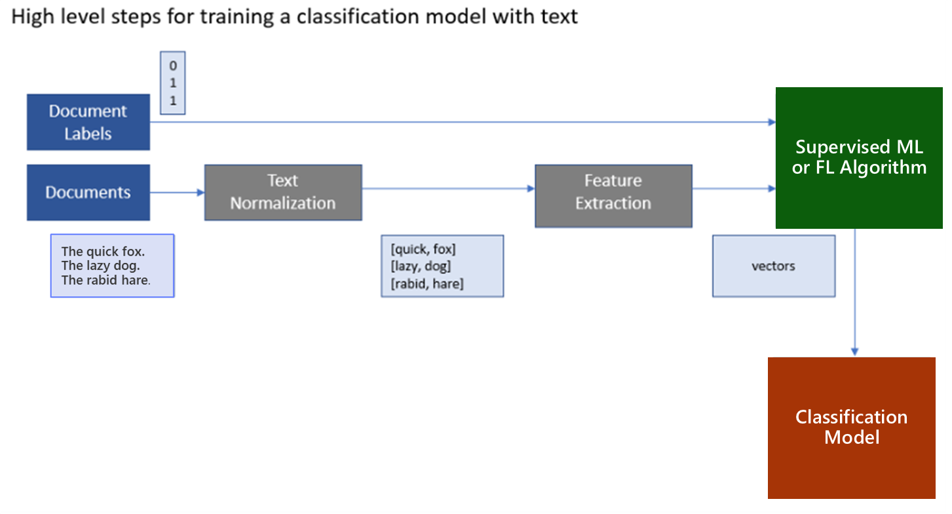
Preferred solution
Classifying claim-text data
General pipeline for text analytics
Notes:
The general pipeline begins by pre-processing or normalizing the text. This step typically includes breaking the text into sentences and word tokens, standardizing the spelling of words, and removing overly common words (called stop words). This phase's output is typically a multi-dimensional array consisting of an array of documents, each having an array of sentences, with each sentence having an array of words. The next step is feature extraction, which creates a numeric representation of the textual documents. A "vocabulary" of unique words is identified during feature extraction, and each word becomes a column in the output. Each row represents a document. The value in each cell is typically a measure of the relative importance of that word in the document. If a word from the vocabulary does not appear, then that cell has a zero value in that column. This approach enables machine learning algorithms, which operate against arrays of numbers, to also run against text. Deep learning algorithms operate on tensors, which are also vectors (or arrays of numbers), so this approach is also valid for preparing text for use with a deep learning algorithm.

Slide 16
Preferred solution
Classifying claim-text data
What data would they need to train the model?
Contoso would need to have a certain amount of historical claim text and have it labeled as home or auto to train a model.

Slide 17
Preferred solution
Classifying claim-text data
What are the common approaches to handle texts for machine learning? Is there a recommended approach to dealing with long descriptive texts that are typically found in claims data?
There are several approaches to vectorize textual data, that include approaches like Term Frequency-Inverse Document Frequency (TF-IDF) vectorization or use of word embedding like Word2vec or Global Vectors (GloVe). The use of embedding to represent words or sentences is considered the-state-of-the art in NLP field. Both Word2vec and GloVe are known to perform similarly, with GloVe claiming to outperform its peers on similarity tasks and named entity recognition. In the scenario, given the descriptive nature of the claims data, it is recommended that Contoso use pretrained GloVe word embedding from nlp.stanford.edu for vector representation of words.

Slide 18
Preferred solution
Classifying claim-text data
Could they use a Deep Neural Networks (DNN) for this?
Yes, they could use a type of DNN called the Long Short-Term Memory (LSTM) recurrent neural network that is shown to work well for text classification problems, especially when used in conjunction with word embedding such as GloVe for word vectorization.

Slide 19
Preferred solution
Classifying claim-text data
Would Keras provide a good starting point for them to work with DNN’s and TensorFlow?
Yes
TensorFlow is a robust framework for performing machine learning, including building neural networks
The Keras library builds upon TensorFlow and provides an easy-to-use and understand high-level API for implementing deep neural networks, complete with tutorials and examples
Models built with Keras are TensorFlow models, so if they choose to move fully towards the lower-level TensorFlow API’s they could do so without having to re-create the models

Slide 20
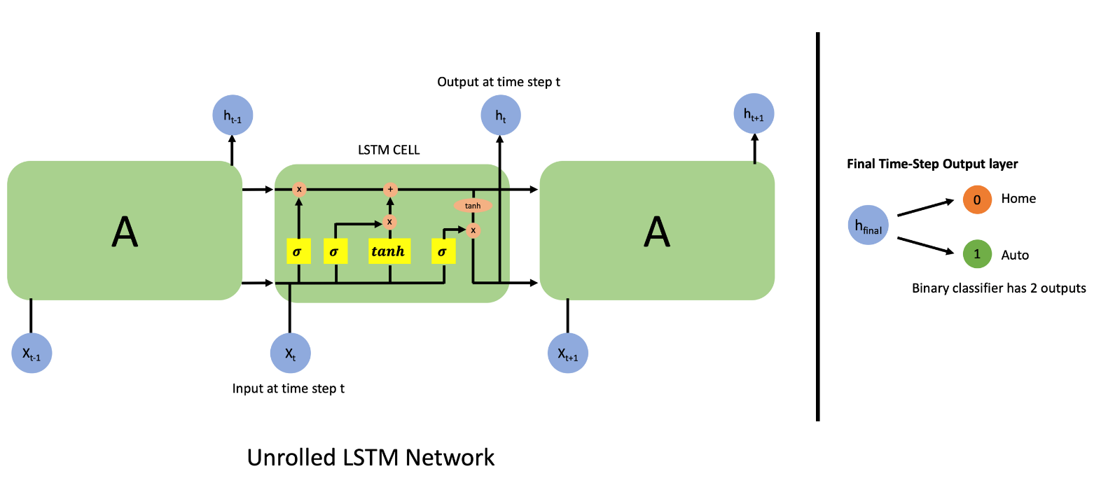
Preferred solution
Classifying claim-text data
What would a LSTM recurrent neural network that performs this classification look like?
Show a snippet of a single layer of an unrolled LSTM network, and the binary classification output at the last step of the network.

Slide 21
Preferred solution
Classifying claim-text data
Psuedo code of network using Keras:
model = Sequential()
model.add(embedding_layer)
model.add(LSTM(100, ..., ...))
model.add(Dense(2))
model.add(Activation('sigmoid'))

Slide 22
Preferred solution
Classifying claim-text data
Psuedo code to define the optimizer, loss function and fit the model to the vectorized data and the labels using Keras:
opt = keras.optimizers.Adam(lr=...)
model.compile(loss='binary_crossentropy', optimizer=opt, metrics=['accuracy'])
model.fit(X_train, y_train, epochs=..., batch_size=..., validation_data=...)
Psuedo code applying model for prediction using Keras and output:
test_claim = ['I crashed my car into a pole.’] pred = model.predict(test_claim) ➔ array([ [0.22, 0.78] ]) # predicts class 1 ("auto insurance claim") with confidence of 78%

Slide 23
Preferred solution
Classifying claim-text data
Describe how you would deploy this trained model at a high level to be available as a web service integrated with the rest of the solution. What Azure Service(s) would be involved?
The trained model is saved to a file.
This file is loaded by web service code that re-creates the model architecture and loads the model weights.
The web service code can then run classifications using the model.
Deploy this service using Azure Machine Learning service.
This captures the web service in a container, deploy the container to Azure Container Service where it can be invoked by any REST client.

Slide 24
Preferred solution
Identifying free-text sentiment
How would you recommend Contoso identify the sentiment in the free-response text provided associated with a claim? Would this require you to build a custom AI model is there a pre-built AI service you could use?
Use the Text Analytics API from Cognitive Services for scoring the sentiment of the claim text
By doing so, they would not have to build or train a custom model, nor have the requirement of having the data to do so
For the solution you propose, what is the range of value of the sentiment score and how would you interpret that value?
The Text Analytics API returns values in the range of 0 to 1.
A value closer to 0 is interpreted as strongly negative sentiment, near 0.5 as neutral sentiment and closer to 1 as strongly positive.

Slide 25
Preferred solution
Summarizing claim text
Can they deploy a predictive web service to Azure Machine Learning services that does not utilize an external model (as in the case with Gensim for summarization) or would support an unsupervised approach (such as clustering)?
Azure Machine Learning services can be used to deploy web services that do not have a model
While the API used to perform the deployment requires a model argument, the argument can refer to any file, and it does not require the use of the file during the web service runtime
Therefore, Contoso could deploy a web service that uses Gensim to perform summarization

Slide 26
Captions, tags, and “reading” images
Preferred solution
How would you recommend Contoso implement support for automatically creating captions and tagging the claim photos?
Contoso should use the analyze feature of the Computer Vision API from Cognitive Services

Slide 27
Preferred solution
Captions, tags, and “reading” images
Describe the flow of processing of an image as input, to what value is returned by each component in your proposed solution for captioning and tagging images.
Either the binary image data or a URL pointing to a publicly accessible image can be supplied
A JSON response document is returned
{'categories': [{'name': 'others_', 'score': 0.39453125},
{'name': 'trans_car', 'score': 0.44140625}],
'color': {'accentColor': '895D42',
'dominantColorBackground': 'White',
'dominantColorForeground': 'White',
'dominantColors': ['White'],
'isBwImg': False},
'description': {'captions': [{'confidence': 0.9485308427051494,
'text': 'a truck is parked on the side of a road'}],
'tags': ['outdoor',
'road',
'truck',
'car',
'traffic']},
'metadata': {'format': 'Jpeg', 'height': 1080, 'width': 1920},
'requestId': '2236f0b9-044f-415f-b772-a9a4ce15728d',
'tags': [{'confidence': 0.9950141310691833, 'name': 'outdoor'},
{'confidence': 0.9936342239379883, 'name': 'road'},
{'confidence': 0.981715738773346, 'name': 'truck'},
{'confidence': 0.749627411365509, 'name': 'transport'},
{'confidence': 0.16133838891983032, 'name': 'trailer'}]}

Slide 28
Preferred solution
Captions, tags, and “reading” images
How would you recommend Contoso implement support for “reading” any text that appears within an image, so that it could be searched later? Would this require you to build a custom AI model is there a pre-built AI service you could use?
Contoso could use the OCR feature of the Computer Vision API

Slide 29
Preferred solution
Captions, tags, and “reading” images
Describe the flow of processing of an image as input, to what value returned by each component in your proposed solution for “reading” images.
Either the binary image data or a URL pointing to a publicly accessible image can be supplied
A JSON response document is returned.
{'language': 'en',
'orientation': 'Up',
'regions': [{'boundingBox': '365,127,937,78',
'lines': [{'boundingBox': '1028,127,274,49',
'words': [{'boundingBox': '1028,141,184,35', 'text': 'POLICE'}]},
{'boundingBox': '365,171,318,34',
'words': [{'boundingBox': '365,171,318,34', 'text': 'EMERGENCY'}]}]}],
'textAngle': 0.0}

Slide 30
Preferred solution
Enabling search
What service would you recommend Contoso use to enable greater searchability over the claim data, inclusive of the new data fields created by your text processing and image processing components?
Contoso should use Azure Cognitive Search to create an Index for the claim data as it enters their system, and augmented by the results of the text and image processing components
Would they be able to keep their claims data in the existing database and layer in this search capability? If so, explain how.
Yes, the data in the Azure Cognitive Search index would augment the data already stored in their SQL Database. The data in the Azure Cognitive Search index would tie back to the data in SQL Database via values used as the primary key in the SQL Database (such as the claim ID, image ID, attachment ID, etc.).

Slide 31
Preferred objections handling
We are skeptical about all the hype surrounding these "AI" solutions. It's hard to know what is feasible versus what is not possible with today's technology and Azure.
While it is true there is a lot of hype around AI, the ability to deploy solutions that use data, machine learning, and deep learning to create an application with “AI” capabilities is real and is possible in Azure.
Azure provides a wide range of services to address the needs of AI, from pre-built AI capabilities in Cognitive Services to services that help you to build, train, and deploy your custom AI capabilities using the Azure Machine Learning service and other services from the Microsoft AI stack.

Slide 32
Preferred objections handling
We know that there are both pre-built AI and custom AI options. We are confused as to when to choose one over the other.
It would be best if you considered the pre-built AI options first. However, if you rule them out because they do not fit your requirements, you should explore the custom AI options.
The advantage of pre-built AI options like Cognitive Services is that the models they use under the covers do not need to be trained by you, and you do not need to have the data to train them as a pre-requisite.

Slide 33
Preferred objections handling
We expect some part of our solution would require deep learning. Do you have any prescriptive guidance on how we might choose between investing in understanding and using TensorFlow or the Microsoft Cognitive Toolkit (CNTK)?
Both TensorFlow and the Microsoft Cognitive Toolkit solve similar problems and have been used successfully by many companies for deep learning solutions.
At present, it appears that TensorFlow has a much larger community interest level, which can be measured by the number of stars it has in its GitHub project (which is an order of magnitude larger than that of the Microsoft Cognitive Toolkit)
The size of the community means that is likely you will more easily find help online for issues with TensorFlow versus the Microsoft Cognitive Toolkit, which is why it may be a good reason to start with TensorFlow

Slide 34
Customer quote
“We are excited by the possibilities made real when we use AI to amplify the capabilities of our agents.”
- Francine Fischer, CIO of Contoso Ltd.

